Slide 1
Knowledge Distillation
Dr. Yan Yan

Slide 2
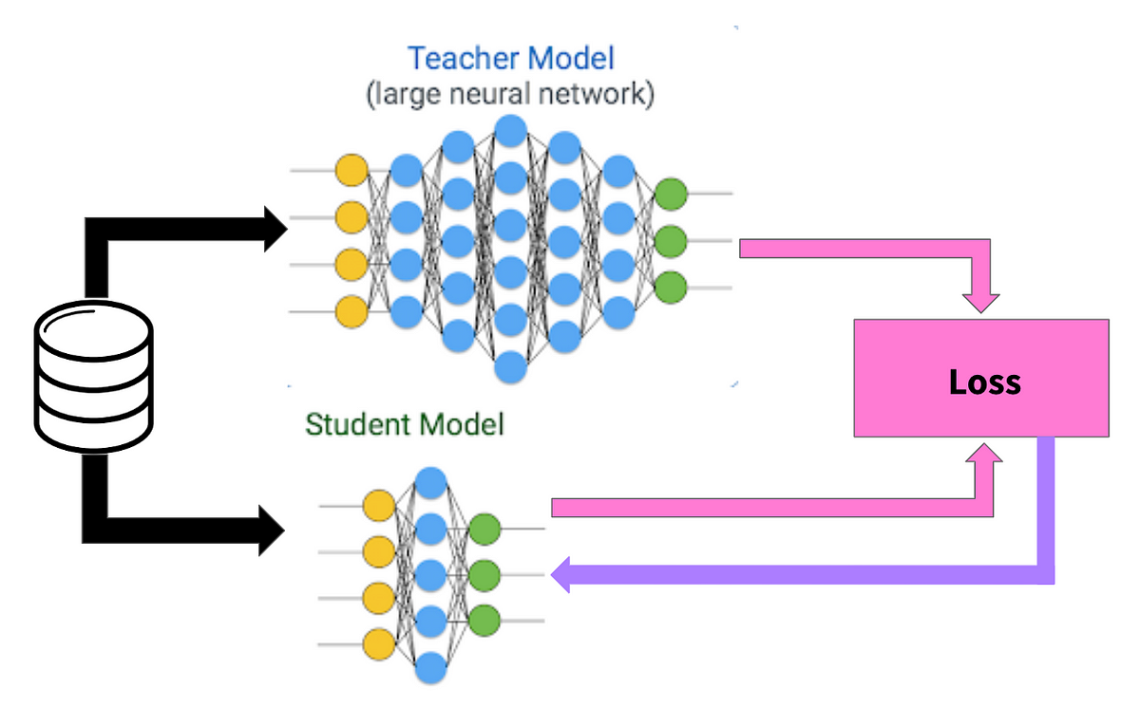
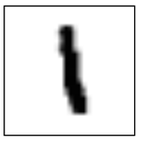
Knowledge Distillation
Model 1
Learning target
Model 2
N Networks
“1”: 0.7, “7”: 0.2, “9”: 0.1
Providing the information that “1” is similar to “7”
Cross-entropy minimization
https://arxiv.org/pdf/1503.02531.pdf
https://towardsdatascience.com/knowledge-distillation-simplified-dd4973dbc764

Slide 3
Knowledge Distillation
Model 1
Learning target
Model 2
N Networks
Ensemble
Average many models
“1”: 0.7, “7”: 0.2, “9”: 0.1
Providing the information that “1” is similar to “7”
Cross-entropy minimization
https://arxiv.org/pdf/1503.02531.pdf
https://towardsdatascience.com/knowledge-distillation-simplified-dd4973dbc764

Slide 4


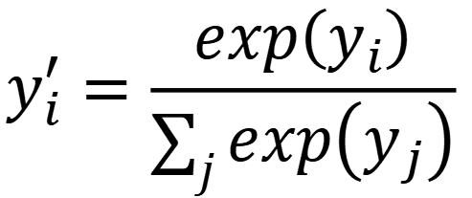












Knowledge Distillation
Temperature for softmax
$$y_{i}^{′}=\frac{exp\left(y_{i}\right)}{\sum_{j}{exp\left(y_{j}\right)}}$$
$$y_{i}^{′}=\frac{exp\left(y_{i}/T\right)}{\sum_{j}{exp\left(y_{j}/T\right)}}$$
$$T=100$$
$$y_{1}=100$$
$$y_{1}^{′}=1$$
$$y_{1}/T=1$$
$$y_{1}^{′}=0.56$$
$$y_{2}=10$$
$$y_{2}^{′}≈0$$
$$y_{2}/T=0.1$$
$$y_{2}^{′}=0.23$$
$$y_{3}=1$$
$$y_{3}^{′}≈0$$
$$y_{3}/T=0.01$$
$$y_{3}^{′}=0.21$$

